Slide 1
Rockbuster Stealth LLC
Data Analysis for 2020 company strategy

Slide 2
Project overview
The aim of this project is to dive into the data of the past and analyze trends to prepare a marketing strategy for this upcoming year. We will be looking for paterns to discover what our current and potential customers want, and prepare an effective plan that get Rockbuster to be on the top streaming services worldwide

Slide 3
What are we analyzing?
The data available for this project was on physical rentings for movies from the year 2006. This data will help us answer some questions that are key to plan the business strategy
Key questions
Which movies contributed the most/least to revenue gain?
What was the average rental duration for all videos?
Which countries are Rockbuster customers based in?
Where are customers with a high lifetime value based?
Do sales figures vary between geographic regions?

Slide 4
Data Overview
Total films 100 | Customers 599 | Countries 108
Languages 6 | Total revenue 61312 | Genres 17
Min. rental rate 0.99 | Min. rental duration 3 | Min. movie length 46
Max. rental rate 4.99 | Max. rental duration 7 | Max. movie length 185
Avg. rental rate 2.98 | Avg. rental duration 5 | Avg. movie length 115.27

Slide 5
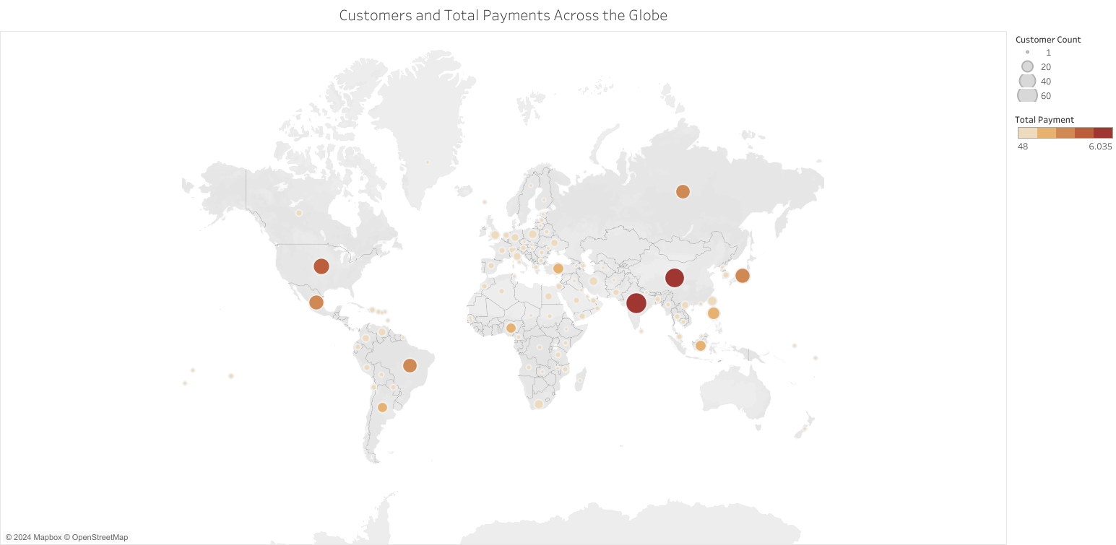
Customers and Total Payments Across the Globe
Total payment
46 6035
Top 5 Countires in customers
India | 60
China | 53
USA | 36
Japan | 31
Mexico | 30

Slide 6
How much do this customers spend on average?
Number of customers
Average per customer
Total revenue
India
60
104.57
6035
China
53
103.83
5251
USA
36
108.05
3685
Japan
31
103.71
3123
Mexico
30
102.23
2985
Top geographic regions: Asia and America

Slide 7
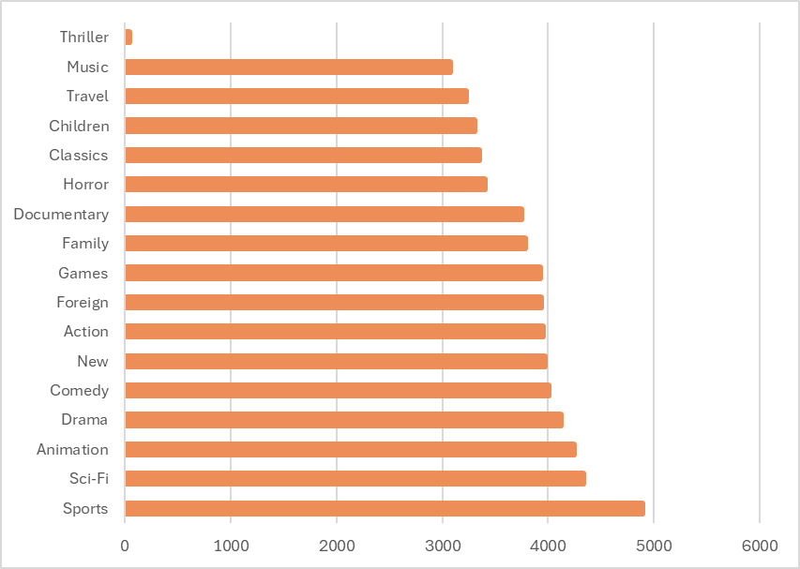
Performance by genre
Sports | 1081
Sci-Fi | 998
Animation | 1065
Drama | 953
Comedy | 851
New | 864
Action | 1013
Foreign | 953
Games | 884
Family | 977
Documentary | 937
Horror | 773
Classics | 860
Children | 861
Travel | 765
Music | 750
Thriller | 11
Number of rentals
Total Revenue

Slide 8
Movie
Revenue
Rentals
Telegraph Voyage | 215.8 | 25
Zorro Ark | 199.7 | 28
Wife Turn | 198.7 | 27
Innocent Usual | 191.7 | 26
Hustler Party | 190.8 | 22
Saturday Lambs | 190.7 | 26
Titans Jerk | 186.7 | 27
Harry Idaho | 177.7 | 27
Torque Bound | 169.8 | 23
Dogma Family | 168.7 | 28
Which movies are the most popular?

Slide 9
Recommendations
What material to include in the catalogue
Top genres are Sports, Sci-Fi,Animation, Drama and Comedy. Titles that lie within those categories will be more appreciated by the customers.
Where can we find potential customers?
Data shows Rockbuster is most popular in India, China, USA, Japan and Mexico, preparing promotions in those areas, especially such as referals from existing customers, can potentially increase the number of clients.

Slide 10
For future projects
Regular manteinance of the inventory to match trends on customers choices.
Tracking searches on the upcoming web page, this will help us see what they want even if it is not in the catalogue.
Collect data from more recent years so we can keep up with customers more effectivelly

Slide 11
Questions?
Thank you for your attention
Núria Miquel
nuria.miquel@rockbuster.com
www.rockbuster.com/contact

